Slide 1
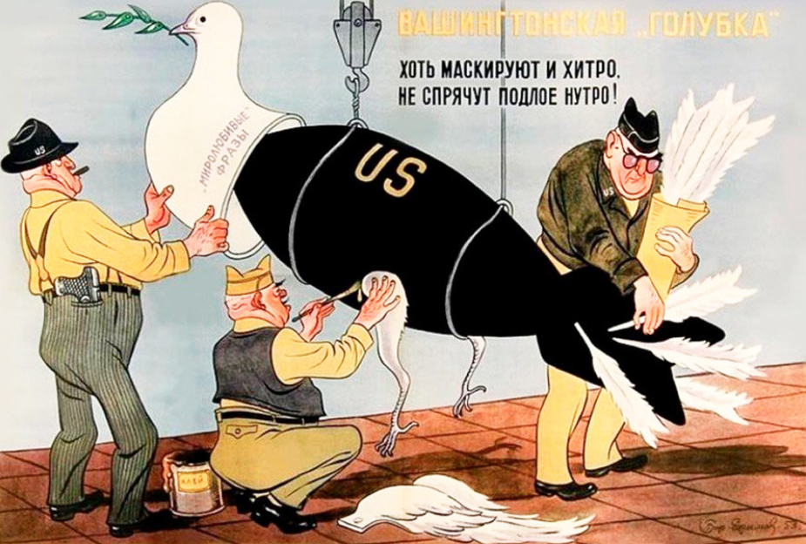
IT9(Group 9)
APSS1L01 Tomorrow’s Leader
Member:
Cheung Tsz Lok Kelvin
Char Cheuk Tung George
Tsang Siu Kee Jonathan
Liu Yim Shan Sandy
Chong Kwan Chuen Martin
Kwok Ming Chi Alex
Venkatesan Jyotsna

Slide 2
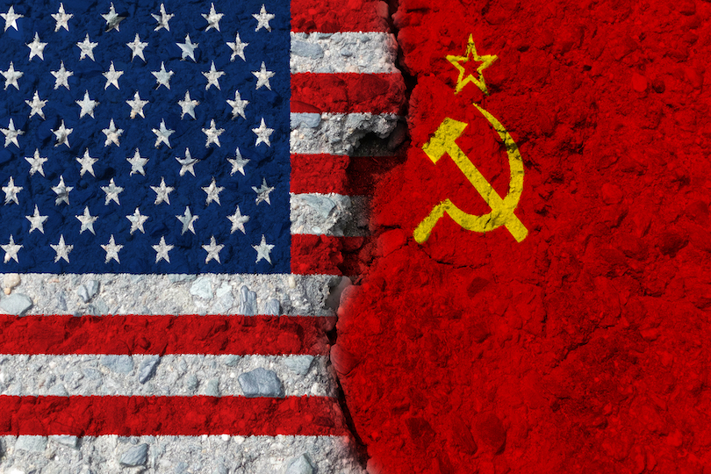
Background
Event: Cold War
Period: 1947-1991
Content:
The Cold War refers to a period of geopolitical tension between the United States and the Soviet Union and their respective allies, the Western Bloc and the Eastern Bloc.
No large-scale fighting directly between the two superpowers, but they each supported major regional conflicts known as proxy wars.
The conflict was based around the ideological and geopolitical struggle for global influence
How to fight: nuclear arsenal development, conventional military deployment, indirect means such as psychological warfare, propaganda campaigns, espionage, far-reaching embargoes, rivalry at sports events, and technological competitions such as the Space Race.

Slide 3
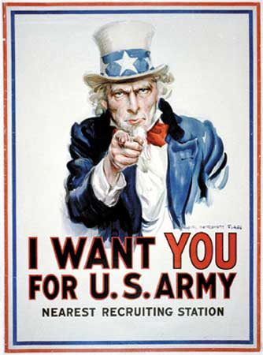
Meaning of "Propaganda"
Propaganda can be a piece of information, especially of a biased or misleading nature, used to promote a political cause or point of view. (Oxford languages)
"Propaganda is used in controversial matters ,but it is also used to promote things that are generally acceptable and noncontroversial.
So there are different kinds of propaganda. They run all the way from selfish, deceitful, and subversive effort to honest and aboveboard promotion of things that are good." (EM 2: What Is Propaganda? (1944)
e.g. This "I WANT YOU" poster is a U.S. Army propaganda that use to recruit.

Slide 4
What does the propaganda imply?
“Washington’s Dove of Peace”
“Though artfully disguised, it does not hide your cowardice”
Making an US missile into a dove (symbol of peace)
The US was trying to use maintaining peace as an excuse to strengthen their military power, as represented by the US missile.

Slide 5

What is the Purpose of Making This Propaganda?
Since in 1949, the US formed the NATO right before the end of the Berlin Crisis as she believed that a long-term military alliance was essential for keeping peace in Europe. The Soviet Union, seeing NATO as a threat against the communist bloc, she decided to make a propaganda to criticize the act of the US, claiming that the US was trying to use keeping peace as an excuse, and strengthening her own military power.
In addition, the USSR used this propaganda to expand her influence of communism in Europe by criticizing the US. She believed that some small countries and nations in capitalist bloc would grow suspicious towards the act of the US and came under the influence of USSR and communism.

Slide 6
What is the effect of the propaganda?
After the Soviet Union launched this propaganda, they wants to influences people to think that USA is hiding the war and the malicious in the slogan of peace, and there are mostly Soviet Union citizens influences by that and think that USA is the enemy of peace and a liar which is make use of the peace.
Also, it influences other countries which is think that USA's unclear bomb is a threat, so that Soviet Union could try to affect these countries and try to union them to confront with USA together.

Slide 7
What is the difference between the fact and the belief of the people at that time?
The fact
The belief of the people
The US formed the NATO to counter the influence of USSR and communism
The US government implement the interventionist foreign policy to prevent communism spreading and this has led to the victory of the US in the Cold War.
The US is only thinking the development of her own military power instead of wanting keeping peace in Europe

Slide 8
Why do people believe such Propaganda
First, it is due to the Lack of cognition in the Foreign Country. The rare number of information channels in the past caused the guiding of people's thinking. Almost all acknowledge of other country is controlled by the government and the newspapers agency, leading people to believe the propaganda.
Second, The national identity, Most of the receivers were Soviets. Meaning that they usually hold a greater faith in their own country and less surety in others, distrusting and denying them. The suspicion towards others would easily be amplified.

Slide 9
End
Thank you for your attention!

